Slide 1
Lecture 10.2
The Future
Andy Aymeloglu - UATX Software Engineering
Notes:
Demos first, then the game for the second half.

Slide 2
Six Problems From Your Own App

Slide 3
The game
For the rest of class I'm gonna hand you six small problems, and every one
  comes straight out of the app you spent ten weeks building - a stat on
  your dashboard, a single message lookup, the model you called in 10.1,
  the login you trust.
Each one looks like something you can already answer, and you should try...
  but the answer your gut gives is usually wrong in a way you can't fix with
  what you know, and that gap is the front door to a whole field of CS with
  its own course and its own people who think about nothing else.
So the game is: I show you the problem, you argue it out, and then I name
  the field you just ran into. Six of them, and that wall you hit is kinda
  the whole point.
Notes:
Get a committed answer out loud before each reveal. Book pointers only if asked.

Slide 4
TRY IT
How many unique people posted today?
# Dashboard stat for your chat app: how many DISTINCT
# users posted at least once today?
#
# Today's posts stream past - about 50,000,000 of them.
# Each one carries a user_id, with lots of repeats: the
# chatty users post hundreds of times each.
seen = set()
for post in todays_posts: # ~50 million posts
seen.add(post.user_id)
answer = len(seen)
# This works. But `seen` now holds every distinct user
# id for the day, in RAM, on every server doing this.
#
# Roughly how much memory does that set need...
# and is there any way around it? ________
Notes:
Estimate set memory out loud first: tens of MB per server. Ask: fixed tiny budget?

Slide 5
Data Structures & Algorithms
The set is correct, and it's also the expensive answer
  if a few million distinct people posted, that's a few million ids sitting in RAM on every
  server running this, and it grows with your user base forever.
Notes:
~12KB, ~2% error, provable. Redis PFCOUNT. Pointer: Mining of Massive Datasets (free online).

Slide 6
Data Structures & Algorithms
The set is correct, and it's also the expensive answer
  if a few million distinct people posted, that's a few million ids sitting in RAM on every
  server running this, and it grows with your user base forever.
You don’t need it if you’re fine with a *little* inaccuracy.
Notes:
~12KB, ~2% error, provable. Redis PFCOUNT. Pointer: Mining of Massive Datasets (free online).

Slide 7
Data Structures & Algorithms
The set is correct, and it's also the expensive answer
  if a few million distinct people posted, that's a few million ids sitting in RAM on every
  server running this, and it grows with your user base forever.
You don’t need it if you’re fine with a *little* inaccuracy.
HyperLogLog
hash each element coming in
take max(number of leading zeros)
probability of getting k leading zeros in a row is 1/2^{k}.
to prevent anomalies and ensure accuracy, the dataset is split into "buckets"
final estimate is the harmonic mean of all the buckets
Trading a little accuracy for a result millions of times smaller. and
  Data Structures/Algorithms is where you learn how to prove/uncover these space/speed tradeoffs
Notes:
~12KB, ~2% error, provable. Redis PFCOUNT. Pointer: Mining of Massive Datasets (free online).

Slide 8
?
Two programs run at once. Both write to memory address 0x1000. Neither clobbers the other. How?
Same numeric address, same physical RAM in the one machine - and yet neither program ever sees the other's value. What gives?
Notes:
Let them guess first. Answer: virtual memory, per-process addresses translated by kernel + MMU.

Slide 9
Operating Systems
The trick is that the address 0x1000 your program sees is a LIE
  A per-program fiction. When your code touches 0x1000 the hardware quietly
  translates it into some completely different real spot in RAM, and it
  translates the other program's 0x1000 to somewhere else entirely.
Notes:
Pointer: OSTEP (free online), Wisconsin OS lectures on YouTube.

Slide 10
Operating Systems
The trick is that the address 0x1000 your program sees is a LIE
  A per-program fiction. When your code touches 0x1000 the hardware quietly
  translates it into some completely different real spot in RAM, and it
  translates the other program's 0x1000 to somewhere else entirely.
Every process gets its own private map of memory, the operating system and
  a chip called the MMU keep those maps, and your pointers never touch
  physical RAM directly - they go through that translation every single
  time, without you ever noticing it's happening.
Notes:
Pointer: OSTEP (free online), Wisconsin OS lectures on YouTube.

Slide 11
Operating Systems
The trick is that the address 0x1000 your program sees is a LIE
  A per-program fiction. When your code touches 0x1000 the hardware quietly
  translates it into some completely different real spot in RAM, and it
  translates the other program's 0x1000 to somewhere else entirely.
Every process gets its own private map of memory, the operating system and
  a chip called the MMU keep those maps, and your pointers never touch
  physical RAM directly - they go through that translation every single
  time, without you ever noticing it's happening.
That same illusion is why a container can think it owns the whole machine
  Machinery of maps, pages, and what the kernel does underneath your code is Operating Systems.
Notes:
Pointer: OSTEP (free online), Wisconsin OS lectures on YouTube.

Slide 12
?
A backhoe cuts the main fiber between you and your server - a whole path through the internet just vanished. Your next message still lands in 40ms. How?
Nobody rerouted it by hand, there's no master map of the internet, and no one is in charge of the whole thing. So how does your packet find a way around the break?
Notes:
Let them propose first. Answer: distributed shortest-path (Bellman-Ford / Dijkstra) recomputed live. BGP if asked.

Slide 13
Computer Networking
The internet is a GRAPH - routers are dots, the cables between them are edges,
  and your packet just needs any path through it from you to the server. There
  is no master map and nobody steering traffic from above.
Instead every router constantly gossips with its neighbors about who it can
  reach and how far, and from that chatter each one works out the current
  shortest path to everywhere - the same shortest-path-in-a-graph problem you
  could state in CS2, just running live and nonstop. Cut a cable and that edge
  disappears, the news ripples outward in seconds, and every router recomputes
  around the gap on its own.
Surviving pieces of the network going down was the original DESIGN GOAL, and
  the graph theory that makes it work is the heart of Computer Networking.
Notes:
Pointer: Kurose & Ross routing chapters, Beej's guide for sockets.

Slide 14
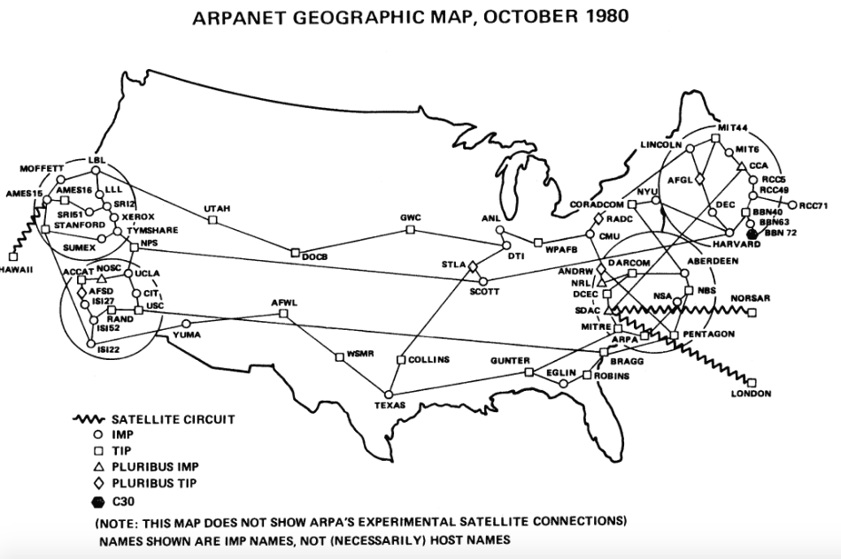
Computer Networking

Slide 15
TRY IT
How does the join not take forever?
# Your chat app: show every message next to its author's
# name. A 1,000,000-row users table, a 10,000,000-row
# messages table.
SELECT messages.body, users.name
FROM messages
JOIN users ON users.id = messages.user_id;
# The obvious way to match them: for each of the 10M
# messages, scan the 1M users for the right id. That's
# 10,000,000 x 1,000,000 = 10 TRILLION comparisons -
# on real hardware, hours.
# Your database returns it in a couple of seconds, so it
# is NOT doing the obvious thing. What is it doing? ________
Notes:
Estimate cost out loud first. Answer: hash join, ~11M steps, picked by the query planner.

Slide 16
Hash join, step 1: build a lookup
STEP 1 - BUILD: read the SMALL table once and turn it into a hash table mapping id -> name.
USERS - 1,000,000 rows
1 alice
2 bob
3 carol
4 dave
...
HASH TABLE (in memory)
1 -> alice
2 -> bob
3 -> carol
4 -> dave
...
read each row once
now any id -> name is ONE step (O(1)).
Notes:
Walk left to right. Cost so far: ~1M, one row per user.

Slide 17
Hash join, step 2: probe
STEP 2 - PROBE: walk the BIG table once; each row looks up its name in the hash table in a single step.
MESSAGES - 10,000,000 rows
hi user_id=2
yo user_id=1
sup user_id=3
...
HASH TABLE
1 -> alice
2 -> bob
3 -> carol
RESULT
hi bob
yo alice
sup carol
hash user_id
O(1)
One pass to build, one pass to probe - about 11 MILLION steps, not 10 trillion.
Notes:
Cost: ~10M, one lookup per message.

Slide 18
Database Internals
It builds a hash table. One pass over the smaller users table turns it into
  a fast id-to-name lookup (a million entries), then it walks the ten million
  messages once and each one does a single O(1) hash lookup to find its
  author - so the whole join is about eleven MILLION steps instead of ten
  trillion. That's a hash join.
And the part that surprises people: you never asked for that. Your SQL said
  WHAT you wanted, not HOW, and a piece of the database called the query
  planner quietly picked the hash join over a couple of other strategies
  based on the table sizes and the indexes that exist - and it can pick wrong.
You wrote JOINs in 2.2 and the engine has been silently choosing how to run
  them ever since - that whole layer is Database Internals.
Notes:
EXPLAIN shows the chosen plan. Pointer: CMU 15-445, Kleppmann's Designing Data-Intensive Applications.

Slide 19
TRY IT
What word comes out?
# In ML, every word gets turned into a long list of
# numbers - a "vector", a point in space. The model
# learns these by reading huge amounts of text
king = [0.50, 0.71, ...] # a few thousand numbers
man = [0.66, 0.20, ...]
woman = [0.62, 0.74, ...]
# Now just do arithmetic on the points:
Notes:
Call out a word before the reveal. Answer: queen (word2vec).

Slide 20
TRY IT
What word comes out?
# In ML, every word gets turned into a long list of
# numbers - a "vector", a point in space. The model
# learns these by reading huge amounts of text
king = [0.50, 0.71, ...] # a few thousand numbers
man = [0.66, 0.20, ...]
woman = [0.62, 0.74, ...]
# Now just do arithmetic on the points:
result = king - man + woman
# `result` lands almost exactly on the vector for one
# specific English word. The model "only does math."
#
Notes:
Call out a word before the reveal. Answer: queen (word2vec).

Slide 21
Machine Learning
It lands on queen. Not because anyone programmed that - because the model,
  from reading enough text, placed every word in a space where DIRECTION
  carries meaning, and the step from 'man' to 'woman' turns out to be the
  same direction as the step from 'king' to 'queen.'
So 'royal' is a direction, 'plural' is a direction, even 'past tense' is a direction.
  Meaning becomes something you can add and subtract.
  This lets a pile of numbers act like it understands language -
  and it's also how your app could find messages about a topic that never
  use the exact word.
These vectors (embeddings) are step one of what's inside the black box
  The rest of that story is Machine Learning.
Notes:
Embeddings also drive RAG. Pointer: Karpathy's Zero to Hero, 3Blue1Brown neural-net videos.

Slide 22
?
The romance of Alice and Bob
They’re exchanging love notes in public. You can see all the characters they’re sending to each other…why can’t you read any of it?
Notes:
Let them argue it's impossible first. Paint-mixing analogy (Diffie-Hellman): mixing easy, un-mixing impossible.

Slide 23
The way out: two keys, not one
Bob makes a matched PAIR of keys at once - locking and unlocking are now DIFFERENT keys.
BOB'S PUBLIC KEY
BOB'S PRIVATE KEY
Locks a message shut. Bob hands copies to anyone - he can post it right on his website.
Opens what the public key locked. Bob shows it to no one, ever.
Lock with the public key, open ONLY with the private key - never the other way around.
Notes:
If asked for the math: N = p*q (primes), d*e = 1 mod totient(N).

Slide 24
Sending a secret over an open wire
Alice's message: "hi bob"
now just gibberish
ALICE
lock w/ Bob's public key
9F3A7C2E 5B...

Slide 25
Sending a secret over an open wire
Alice's message: "hi bob"
now just gibberish
ALICE
lock w/ Bob's public key
9F3A7C2E 5B...
over open WiFi
BOB
unlock w/ PRIVATE key -> "hi bob"

Slide 26
Sending a secret over an open wire
Alice's message: "hi bob"
now just gibberish
ALICE
lock w/ Bob's public key
9F3A7C2E 5B...
over open WiFi
BOB
unlock w/ PRIVATE key -> "hi bob"
EAVESDROPPER ON THE WIFI
sees the ciphertext AND Bob's public key - and still can't read it.

Slide 27
Cryptography & Security
Locking is easy and unlocking-without-the-private-key is effectively impossible.
  That gap comes from one-way math: multiplying two enormous
  prime numbers together is quick, but taking the result and factoring it
  back into those primes would take longer than the age of the universe
  Bob can publish the product as his public key and give nothing away.
When you load an https:// site your browser grabs the server's public key.
  It uses it to safely agree on a fresh throwaway key just for this session.
  It encrypts the rest of the conversation with that fast shared key
  Thus, nobody on the UATX WiFi can read your password, despite seeing every byte you sent.
Notes:
Answers the 9.2 coffee-shop WiFi question. Pointer: Computerphile paint video, cryptopals.com, Boneh's course.

Slide 28
TRY IT
Does this program stop?
# Imagine a perfect checker: a function halts(f) that
# returns True if f() eventually stops, and False if f()
# runs forever. Always answers, always right. (Your CI
# could finally reject any accidental infinite loop.)
#
Notes:
Turing, 1936. Walk both branches on the board, each answer contradicts itself.

Slide 29
TRY IT
Does this program stop?
# Imagine a perfect checker: a function halts(f) that
# returns True if f() eventually stops, and False if f()
# runs forever. Always answers, always right. (Your CI
# could finally reject any accidental infinite loop.)
#
# If we had it, nothing stops us writing this:
def doIHalt():
if halts(doIHalt): # "do I, trouble, ever stop?"
while True: # yes? then loop forever
pass
else: # no? then stop right now
return
Notes:
Turing, 1936. Walk both branches on the board, each answer contradicts itself.

Slide 30
TRY IT
Does this program stop?
# Imagine a perfect checker: a function halts(f) that
# returns True if f() eventually stops, and False if f()
# runs forever. Always answers, always right. (Your CI
# could finally reject any accidental infinite loop.)
#
# If we had it, nothing stops us writing this:
def doIHalt():
if halts(doIHalt): # "do I, trouble, ever stop?"
while True: # yes? then loop forever
pass
else: # no? then stop right now
return
# So... does doIHalt() stop? Try it BOTH ways:
# if halts(doIHalt) is True, what does doIHalt do?
# if halts(doIHalt) is False, what does doIHalt do? ________
Notes:
Turing, 1936. Walk both branches on the board, each answer contradicts itself.

Slide 31
Computability
The only way out is that halts() can't exist in the first place.
  Not 'we haven't built it yet' or 'it'd be too slow' - it is provably impossible for
  ANY program to look at any program and always say whether it stops.
Some perfectly clear yes/no questions can’t be programmatically answered.
  It's why no linter or test suite can catch every infinite loop.
  Mapping out what's computable at all is Computability.
Notes:
Pointer: Sipser, Computerphile halting video, Petzold's The Annotated Turing.

Slide 32
Where this goes next
Notes:
Close on what they did: shipped a working app end to end in ten weeks.

